Slide 1
Today’s Topics
Week 8: Design, User Experience & Delivery
Week 9: Explanation & Exploration
Homework Review
Final Project Review, Questions

Slide 2

Visualizing for Everyone:
Exploration & Explanation
Week 9
Mar 8, 2016

Slide 3
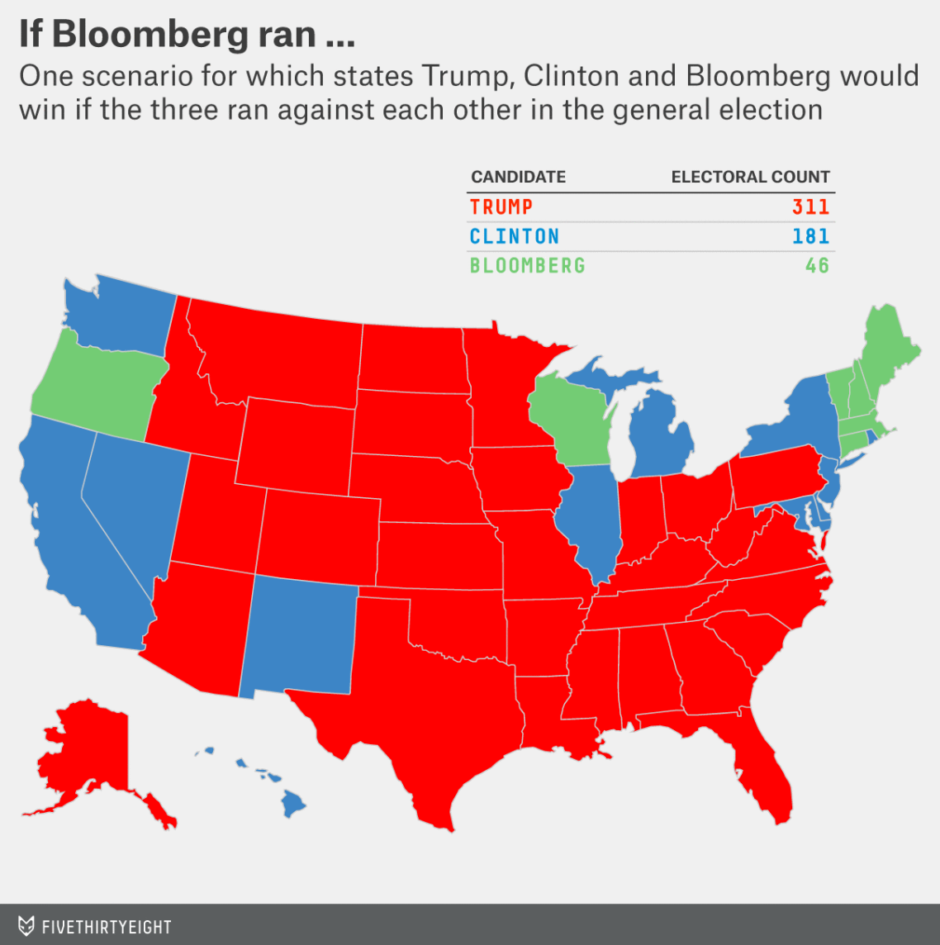
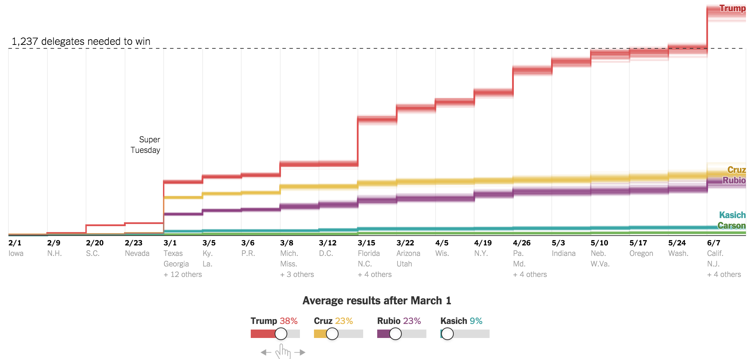
Exploration and Explanation
Explanation tells a particular story while exploration invites the viewer to dig in further and figure things out themselves.

Slide 4
Explanation versus Exploration
Explanation
Static
More text
Less interaction
Less time-consuming
Fewer dimensions
Executive-ready
Not usually an app
Typical user: web user
Exploration
Dynamic
Less text
More interaction
More time-consuming
More dimensions
Expert-ready
Guide on how to use
Usually an app
Typical user: data analyst
Explanation & Exploration
Consistent style and formatting
Titles, labels, legends
Data source attribution
Pay attention to platform (mobile, PC, etc)

Slide 5
Do you know the answer?
Yes
Confirmed hypothesis
Simple(ish) answer
Explanation
No
Refuted hypothesis
Nuanced answer
Exploration

Slide 6
Who will be using the visualization?
Mass market
Less familiar users
Blog/news users
Executives
Explanation
Data scientists
Experts in the field
Colleagues
Advanced users
Exploration

Slide 7
Will there be time to explore?
No time
Housing market news
Trump story
Global warming story
Explanation
Lots of time
Shopping for a home
Election research
Global warming analysis
Exploration

Slide 8
How will the visualization be presented/consumed?
Mobile
Web page
Powerpoint slides
Report
Meeting/presentation
Explanation
Application (Excel, Tableau, etc)
Web page/app
Small, working meeting
Exploration

Slide 9
A lot of dimensions & measures in the data?
No
Revenue over time
Part to whole
All data can be charted at once
Explanation
Yes
Comparing two continuous measures
Geography, over time, with many categories
A single chart would be a noisy mess
Exploration

Slide 10
Does the data require a narrative to explain?
Yes
More to the story than just data
Disparate data sources
Explanation
No
You don’t yet know the narrative
A single data source
Exploration

Slide 11
Qumulo:
Storage Exploration

Slide 12
Qumulo: Why customers visualize
Data scales infinitely, but human perception and comprehension does not.
System is complex, but need to convey data and information simply.
Help customers grow their data and their understanding of it.
Save time, minimize frustration, maximize actionability.

Slide 13
Qumulo: Mostly Exploration, Currently

Slide 14
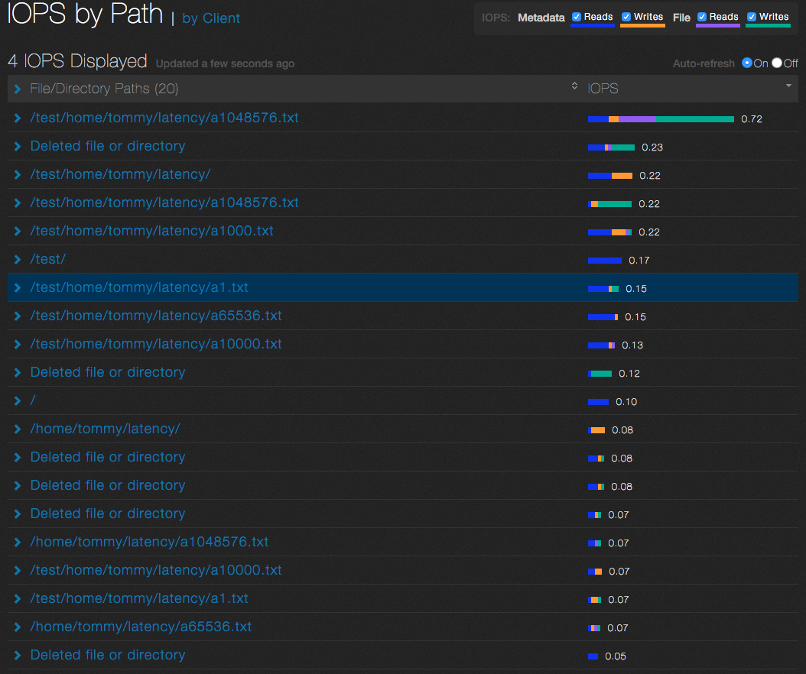
Exploring Activity by Path

Slide 15
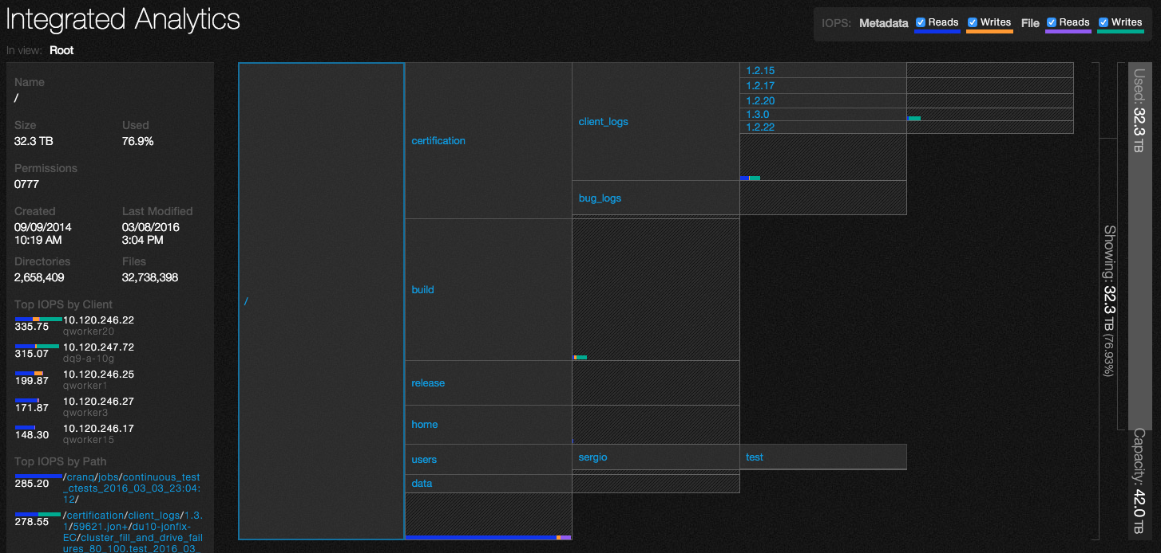
An Exploratory Dashboard

Slide 16
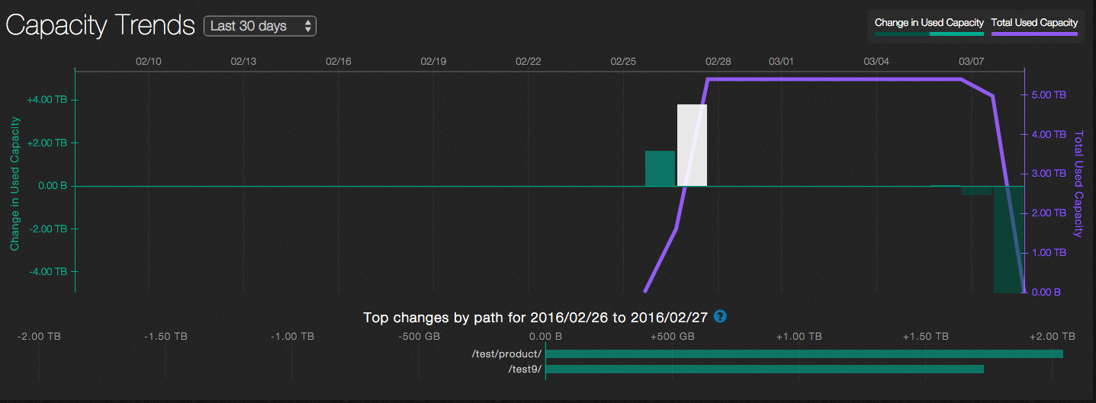
Exploring (and explaining) Capacity Trends

Slide 17
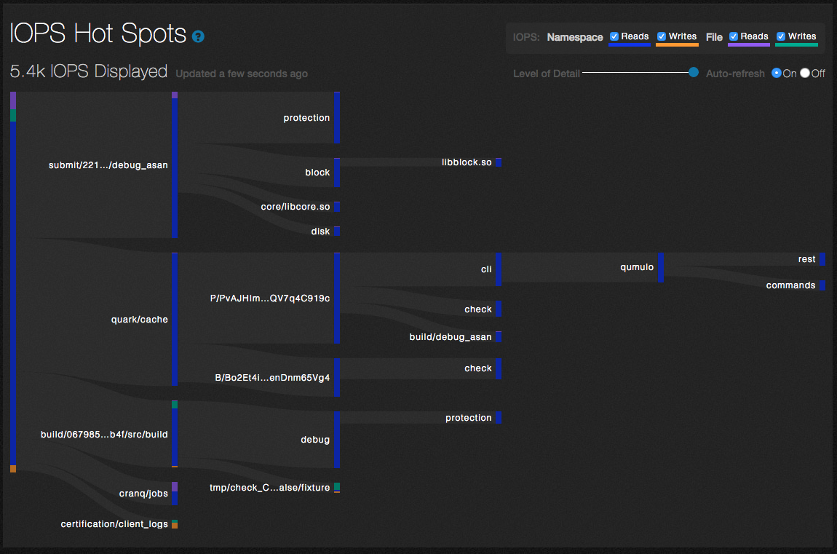
Explaining a complex tree and activity

Slide 18
Data Science:
The next level of Explanation

Slide 19
FANG: Facebook, Amazon, Netflix Google

Slide 20
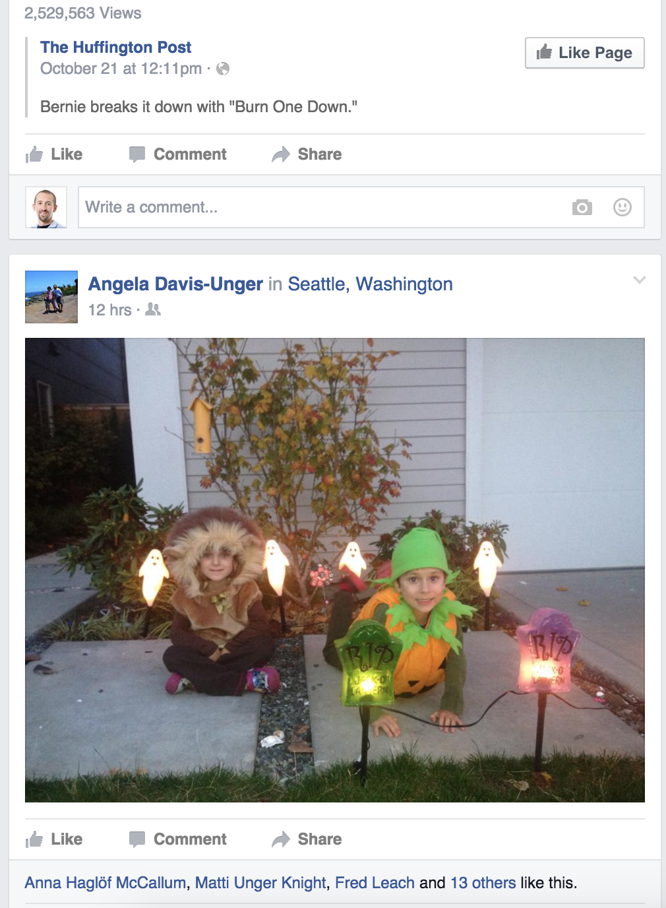
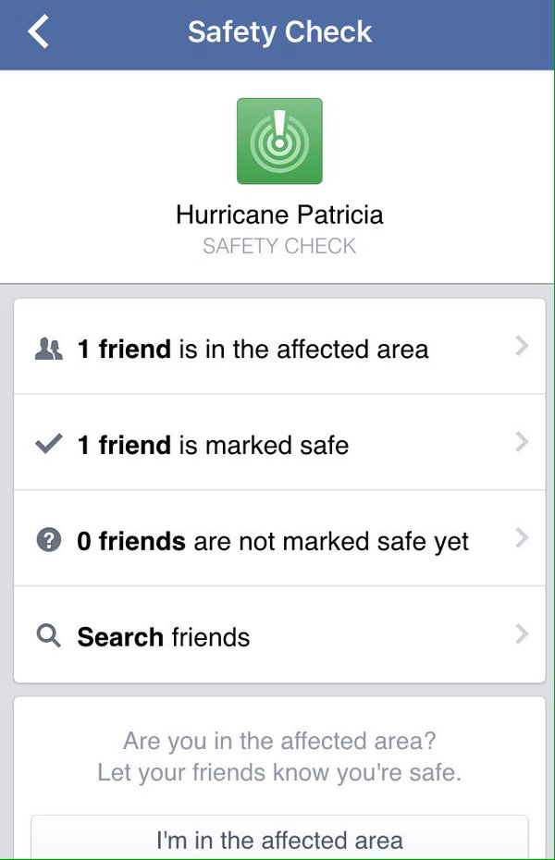
Facebook feed and features
The feed is one big algorithm. New features leverage the massive Facebook network.

Slide 21
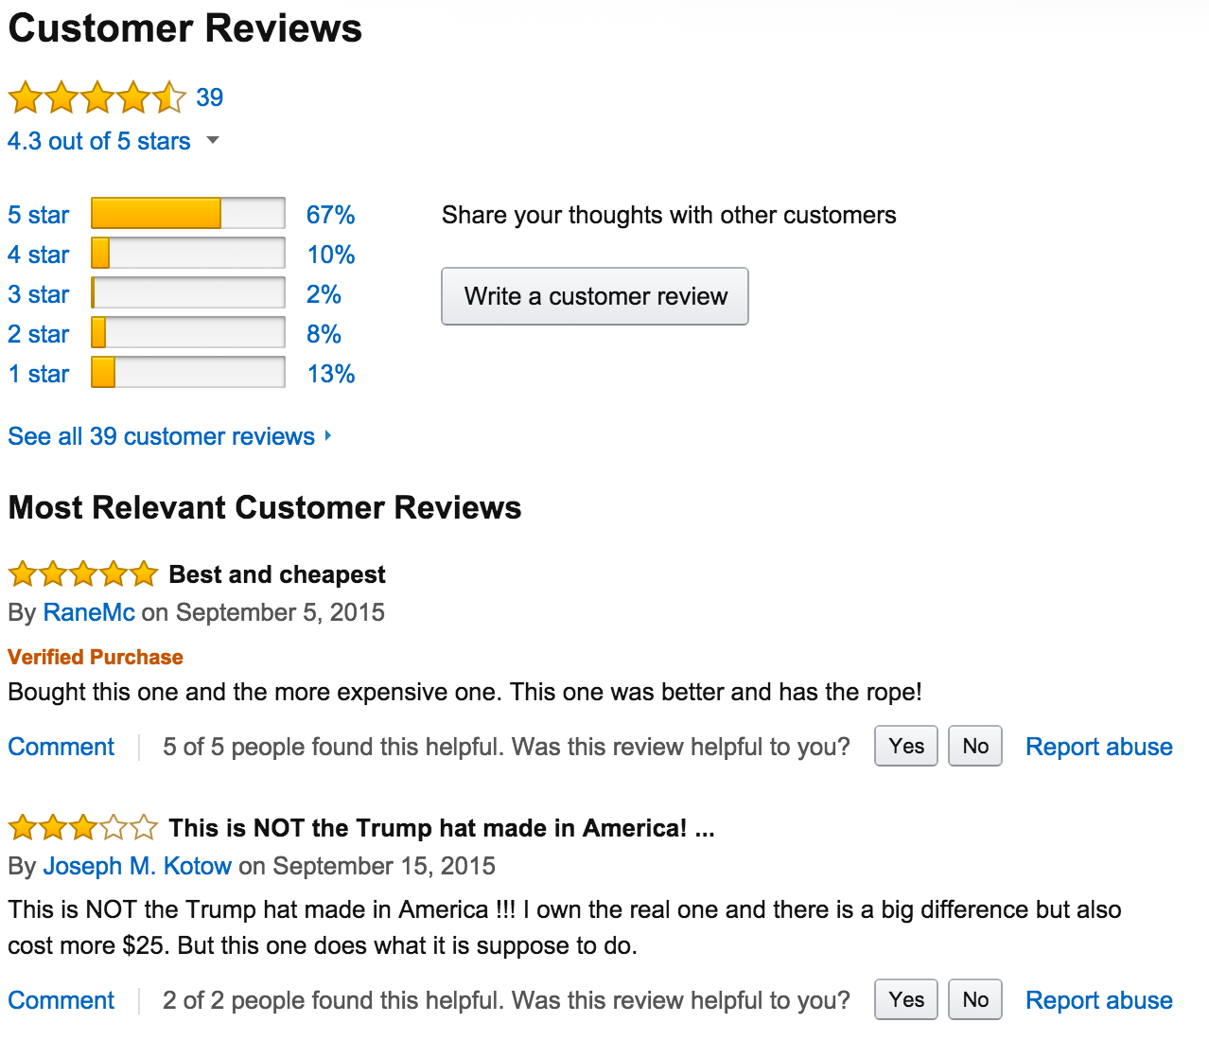
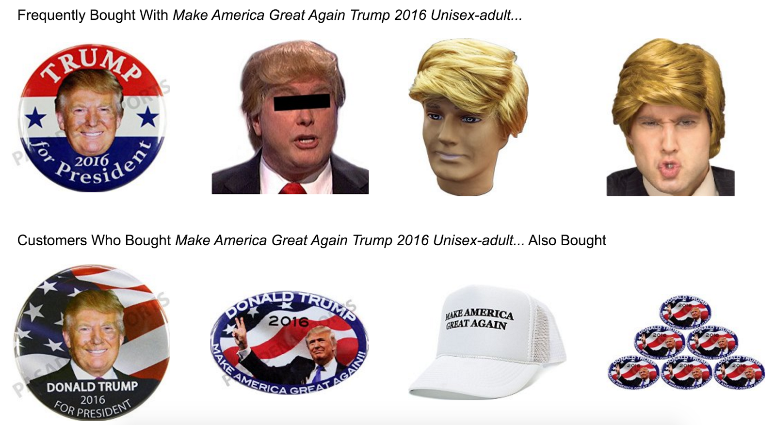
Amazon Reviews and “Also Bought”
Other customer’s opinions is critical to decision. Only “viz” on Amazon. The “also bought” section is a visual “explanation”

Slide 22
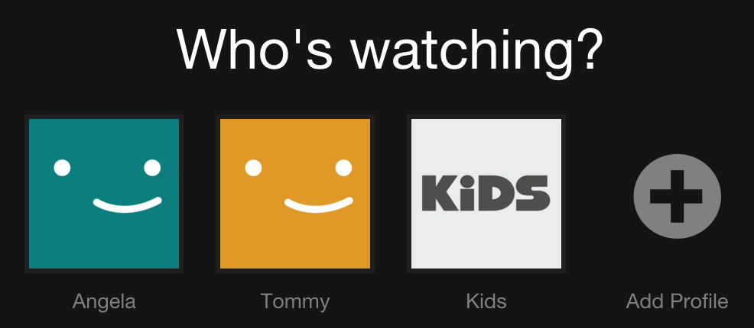
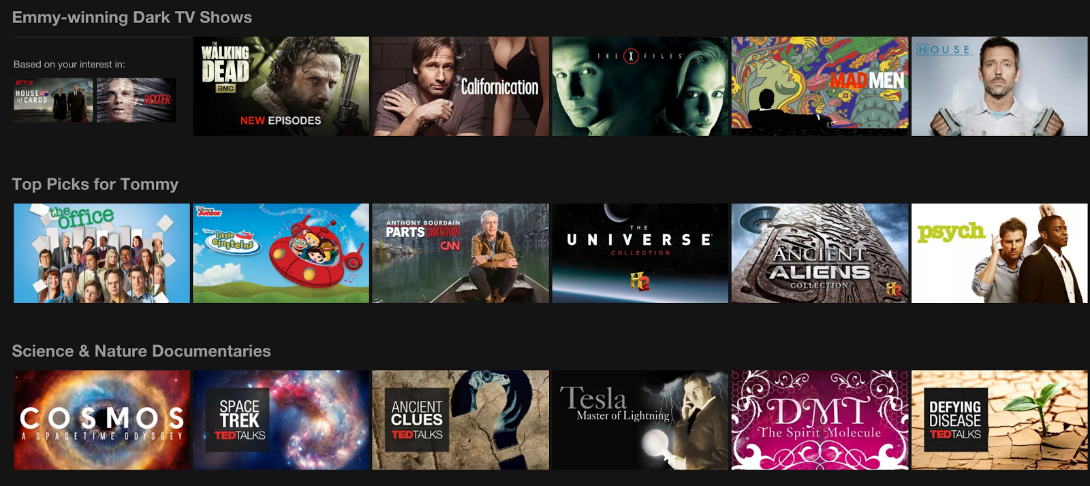
Netflix Recommendations
Customizing content and presenting similar movie/show recommendations. (See: Netflix Prize)

Slide 23
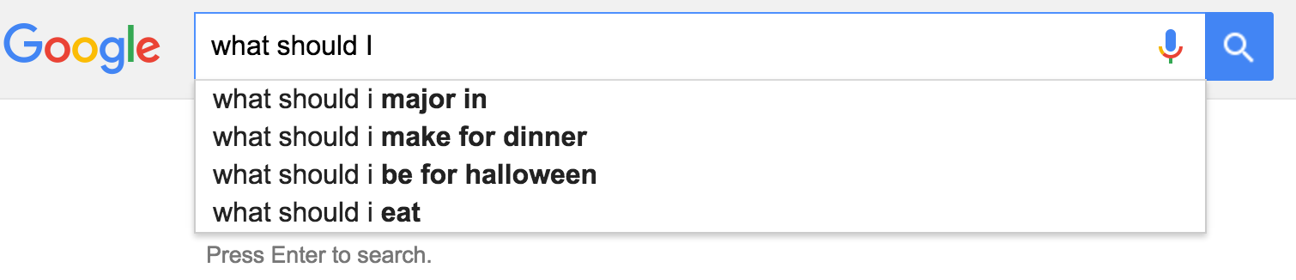
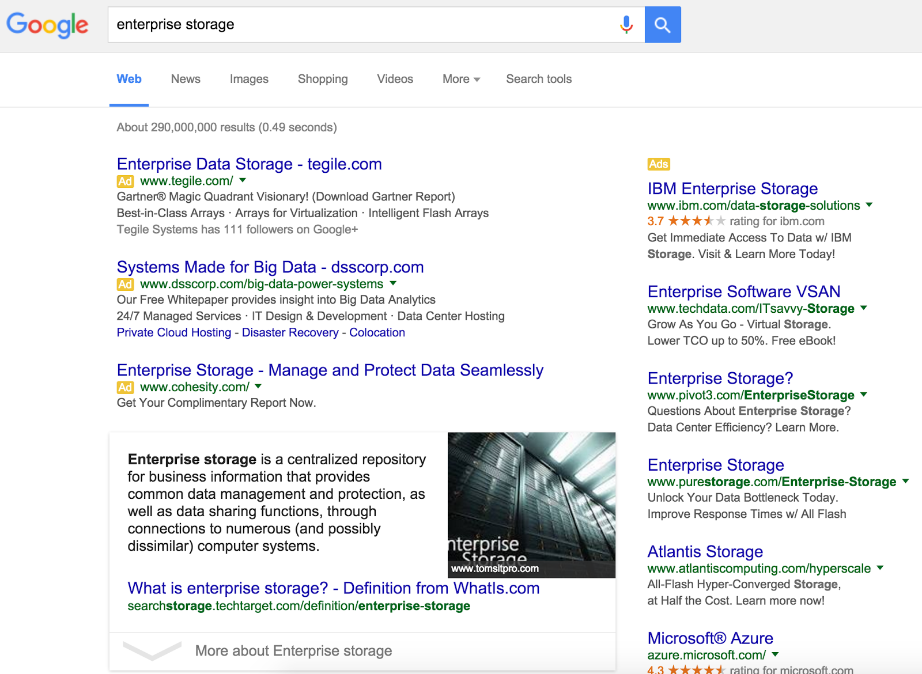
Google Search
Google appears to be reading my mind. But, they’re also trying to make money.

Slide 24
Other examples: Zillow’s Zestimate – just a number Redfin “Hot Homes” – just an icon

Slide 25
Homework:
Database connection review

Slide 26
Homework Highlights
Carson
A lot of attention to detail in terms of formatting, style, etc:
https://public.tableau.com/profile/carson4902#!/vizhome/TransitTowns10-14/Dashboard1
Katherine
Good, story, styling, consistent narrative
https://public.tableau.com/profile/publish/DellInternationalSales/Story1#!/publish-confirm
Amelia
Combined Starbucks data and inspection data. Great approach. I'm not sure how she did it.
https://public.tableau.com/profile/amelia.kohm#!/vizhome/Starbucks_Inspections/Dashboard1
Glenn
Crime in Seattle, by year and type is an interesting look at the data.
https://public.tableau.com/profile/glenn.melton#!/vizhome/Assignment6_26/SeattlesRecentCrimeStory

Slide 27
Homework Highlights
Use a larger color range and or discrete colors rather than gradient for better color differentiation.
When putting a bunch of words in a word cloud, or really anywhere, be aware of the negatives of all caps Regular expression replace?
Pay close attention to map experiences. Tableau's default is probably not ideal in some cases.
Treemaps, while pretty, should generally be use for well-organized data, with good categories.
Watch out for excessive overlap of shapes on maps.
Tableau public mapping is not great. Doesn't handle "large" amounts of data or mapping very well.
Pay attention to how people will view the visaulization. Watch out for scrolling (or lack thereof)
From crime, to Starbucks, when doing heat maps, it's always nice to have a per-capita perspective.
When showing "temporal" data (data with a time element), you should almost always order the data by the date, otherwise people can't decipher the tend over time.
Double check your work. Does it make sense? Does it tell an expected or unexpected story?
For visualizations, just because you can, doesn't mean you should.
Be careful when joining data. It can lead to overestimates.
Comparing two things. "barbell" chart: http://vizwiz.blogspot.com/2015/06/dnacharts.html
Verify your data and data types. (Thanks Rachel!)

Slide 28
Final Project: Questions, Review

